Slide 1


Clean Water and Sanitation
This presentation delves into the critical topic of clean water and sanitation, focusing on SDG 6, a key goal for achieving a sustainable future.
by Daisy Obuya
DO

Slide 2

Project Overview
1
Objective
2
Scope
Analyze and visualize data related to SDG 6, to improve access to clean water and sanitation.
Data-driven insights on water quality, access, and sanitation facilities, with a focus on specific regions and global trends.

Slide 3
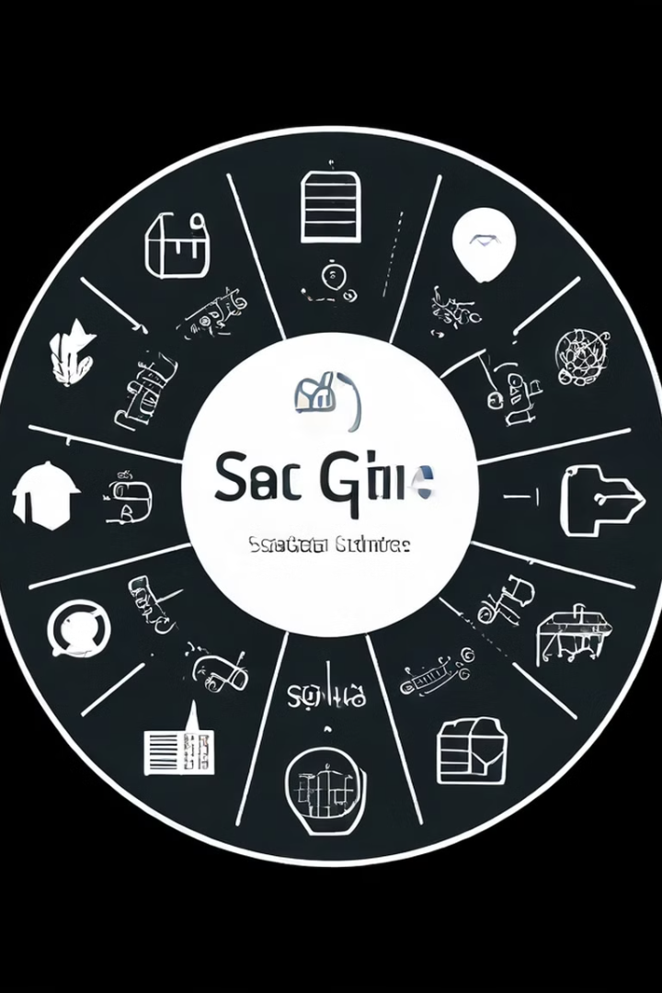
SDG 6 Alignment
Goal
Relevance
Ensure availability and sustainable management of water and sanitation for all.
Addressing global water crises, promoting equitable access, and enhancing sanitation infrastructure.

Slide 4
Problem Definition
The Problem
Significance
Insufficient access to clean water and sanitation in many regions, leading to health issues and socio-economic disparities.
Understanding and addressing these issues is crucial for improving public health, reducing poverty, and promoting sustainable development.

Slide 5
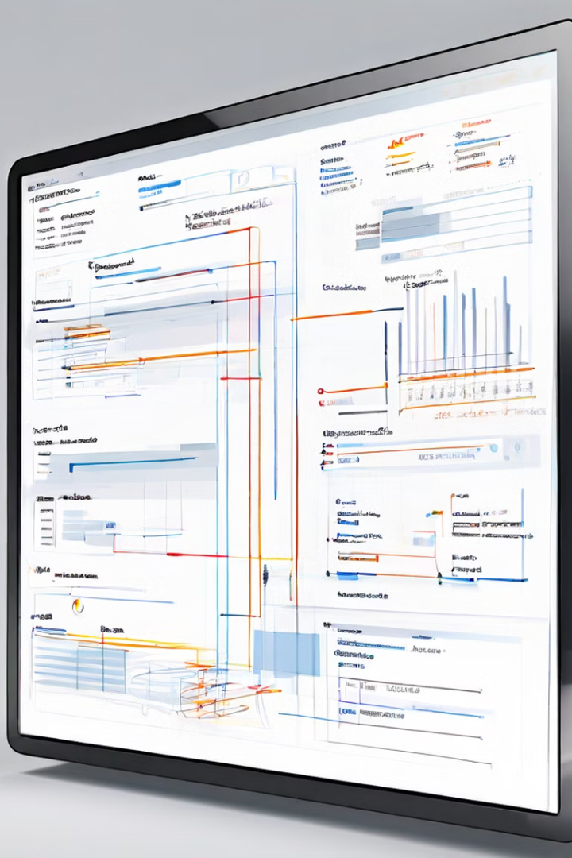
Database Design Overview
Table
Key Fields
Water Quality
pH, contaminants, source
Access
Population percentages with water and sanitation access
Infrastructure
Water treatment facilities, sanitation systems

Slide 6




Database Schema Visual
Tables
Relationships
Key Fields
Representing data entities, such as water quality, access, and infrastructure.
Connections between tables, showing how data is linked together.
Essential attributes within each table, used for data analysis and reporting.

Slide 7
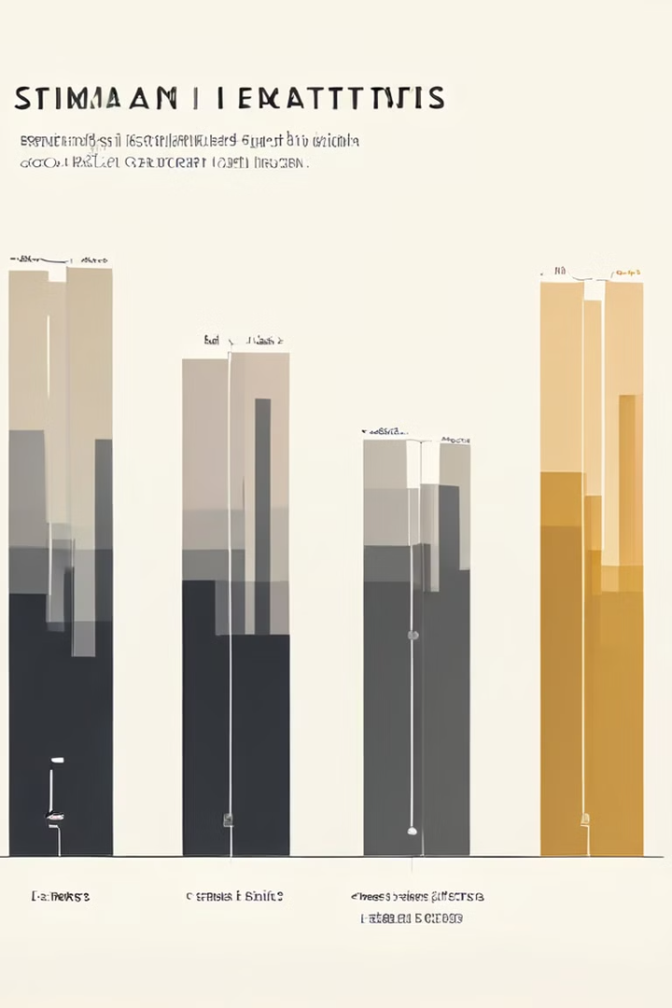
Key Data Analysis Insights
1
Insight 1
2
Insight 2
Schools with the highest water contamination rates, highlighting areas needing urgent attention.
Correlation between sanitation infrastructure investment and health outcomes, demonstrating the impact of improved infrastructure.
3
Insight 3
Trends in access to clean water over the past decade, showcasing progress made and areas needing further improvement.

Slide 8
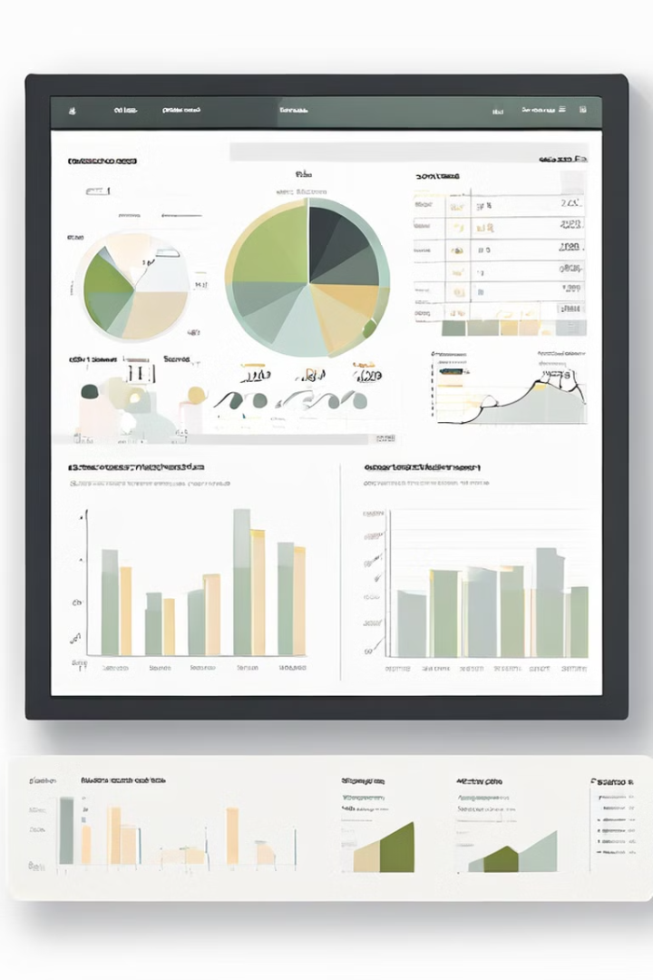



Excel Dashboard Overview
Charts
Visualizing key data trends, like water access rates over time.
Tables
Presenting detailed data breakdowns, like water quality metrics for different schools.
Interactive Elements
Enabling users to filter data, drill down into details, and explore specific aspects of interest.

Slide 9

Excel Dashboard Demonstration
Data Refresh
Filters
Ensuring that the dashboard is up-to-date with the latest data, reflecting current trends.
Selecting specific regions, years, or metrics to focus analysis.
1
2
3
Drill-downs
Exploring details within charts and tables, providing deeper insights into data points.

Slide 10

Conclusion and Next Steps
Summary
Next Steps
The project has provided valuable insights into understanding and addressing SDG 6 challenges, highlighting key data trends and areas needing improvement.
Suggestions for further analysis, potential improvements to the database, and ways to expand the dashboard’s capabilities.

